Slide 1
Multistage Clustering Method for
Unsupervised Aspect Mining
Shi Feng
2012 ACM Class

Slide 2

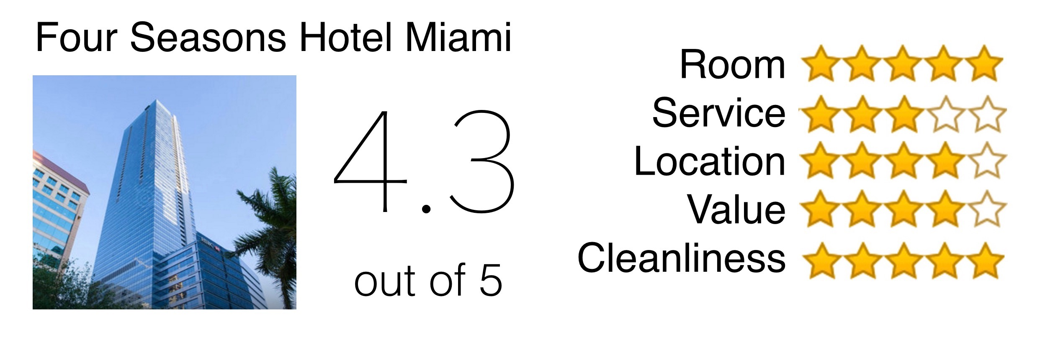
Review Summarization

Slide 3

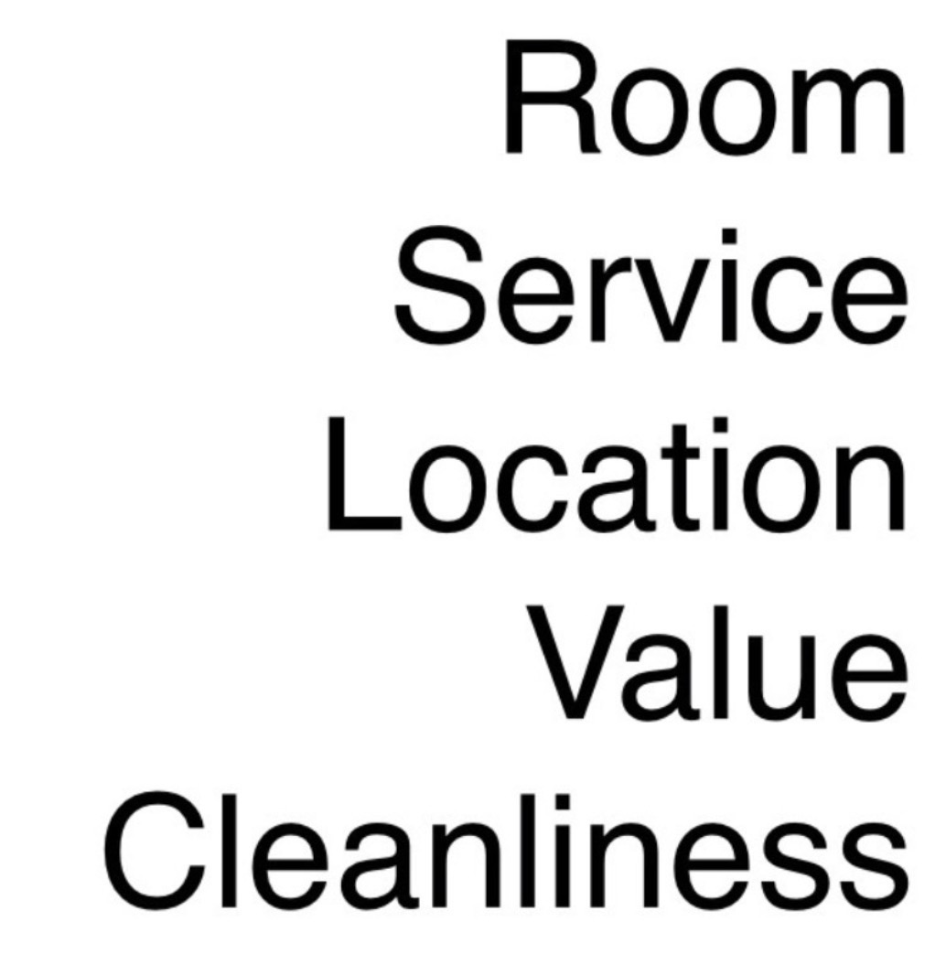

Aspect-based Review Summarization
Aspects
Ratings

Slide 4
Aspect-based Review Summarization
Given
by retailer
Given
by user

Slide 5

Aspect-based Review Summarization
Amazon has over
200 million products
Given
by retailer

Slide 6
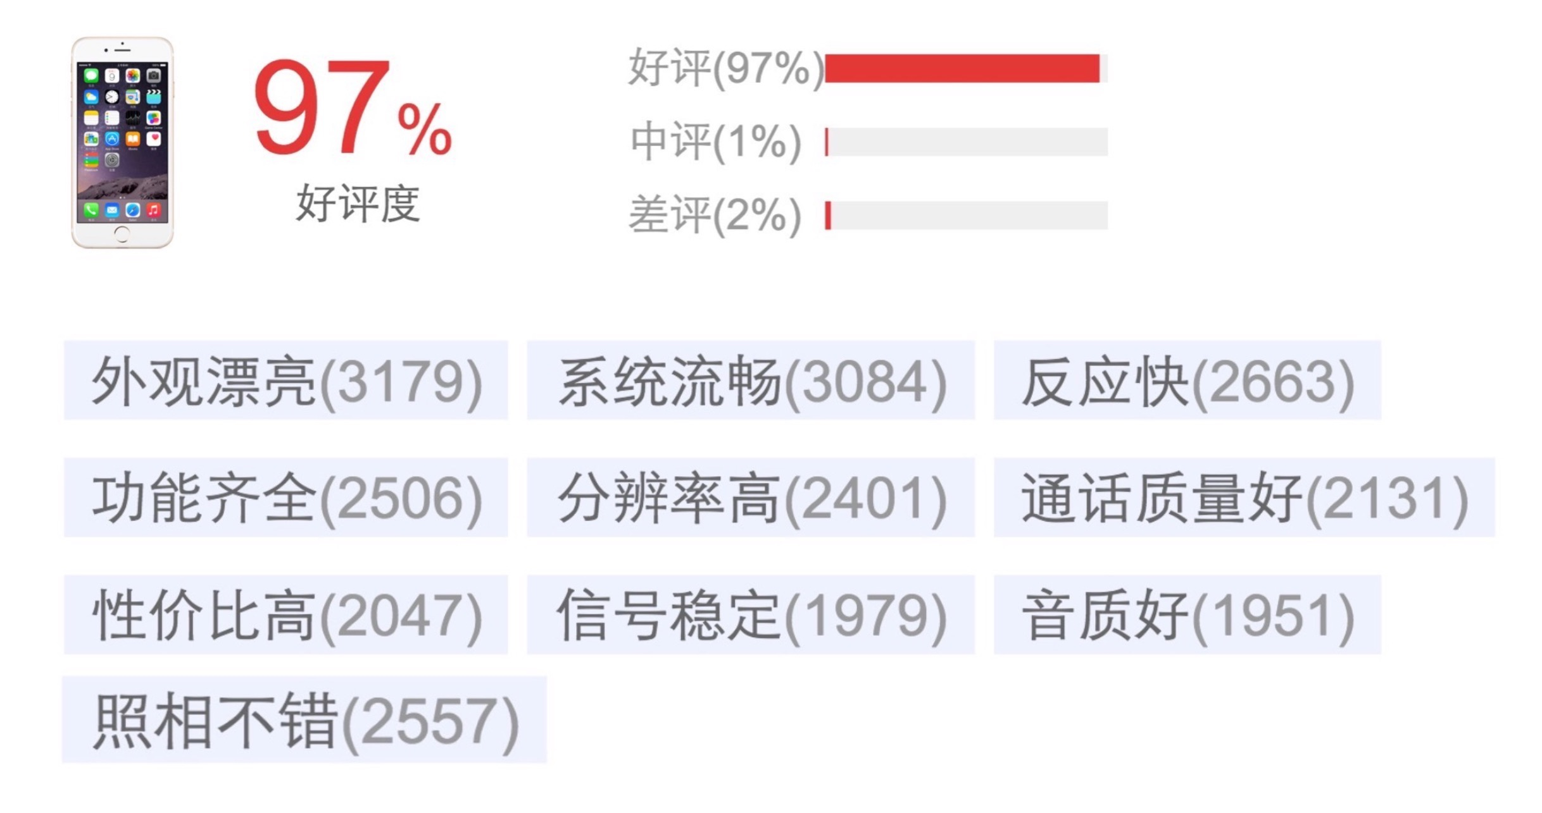
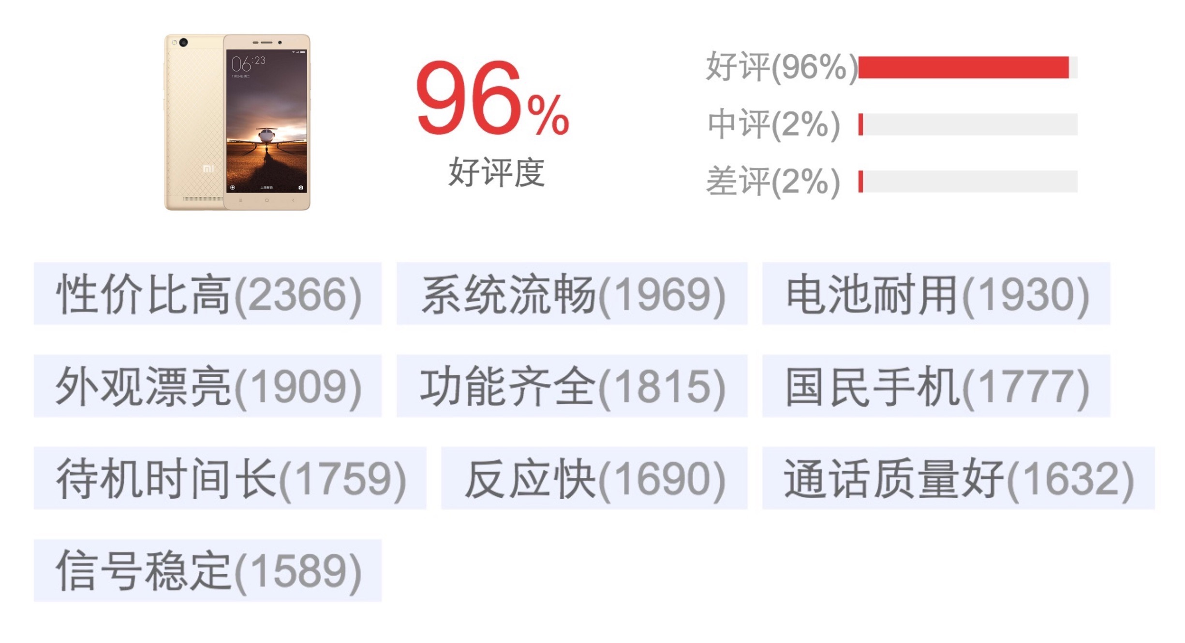
Automatic Review Summarization

Slide 7

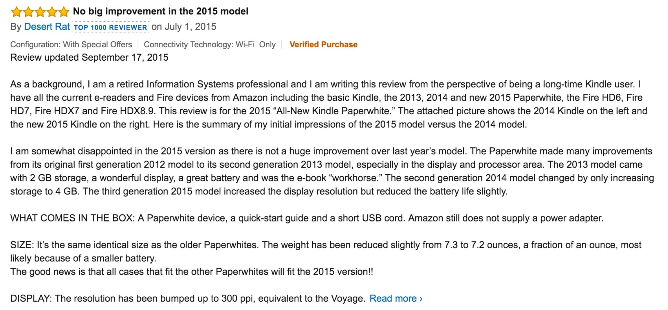

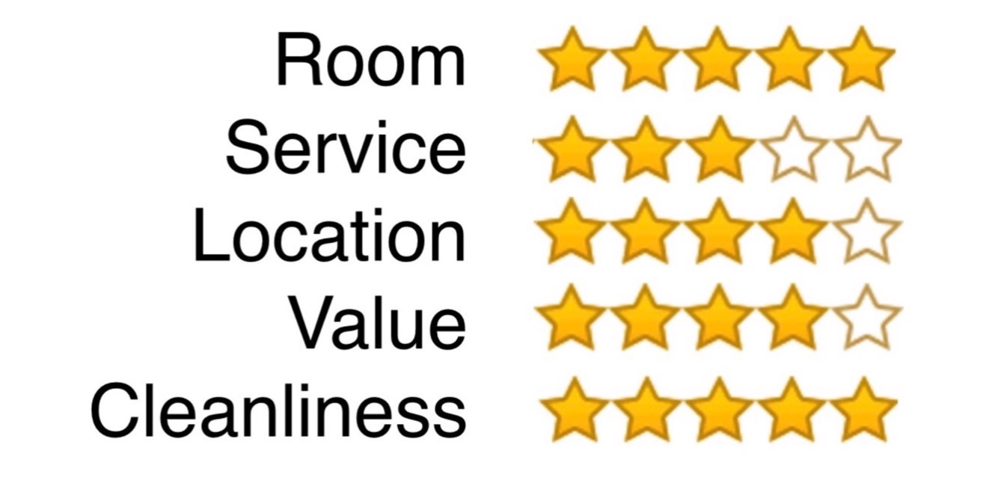
Automatic Review Summarization

Slide 8
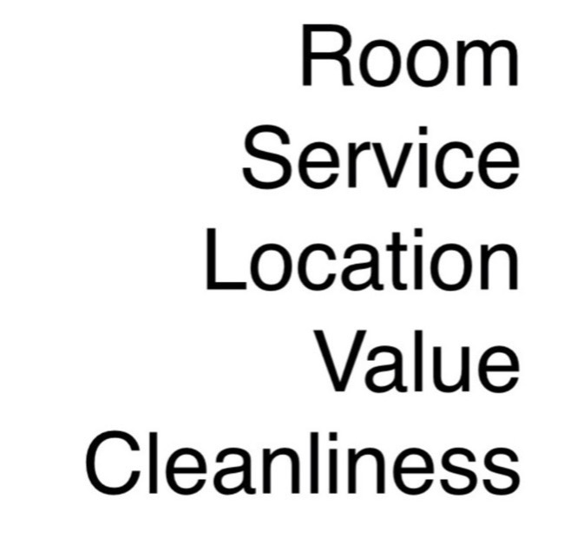

Aspect Extraction

Slide 9
Difficulties
We talk about two difficulties about aspect extraction on user review data:
The shift of topics
The rooms are very clean. Breakfast is nice and there is also a nice restaurant right next door.
The mix of opinion and context
The staffs are very helpful. The lady at the checkin table answered all our questions about paris very patiently.
Structures in the reviews. Bag-of-word is too simple.

Slide 10
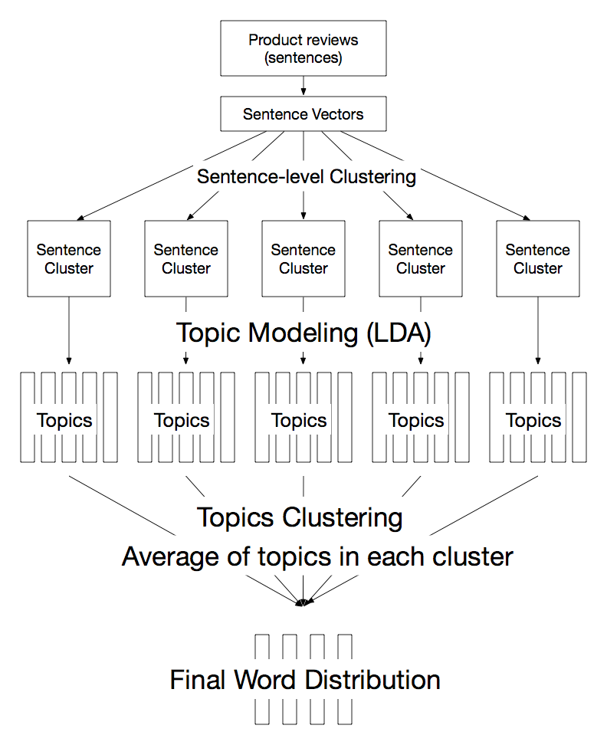
3-stage Clustering
Coarse-grain
Sentence level
Fine-grain
Word level

Slide 11
3-stage Clustering
Coarse-grain
Sentence level
Fine-grain
Word level

Slide 12
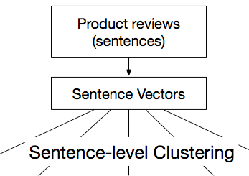
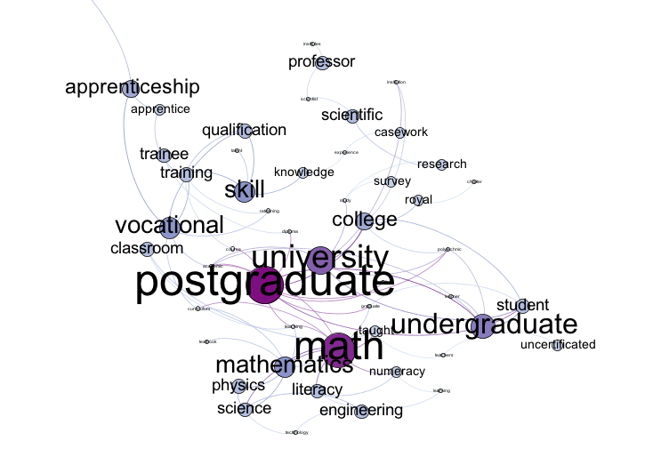
Sentence-level Clustering
Sentence Vector (Le et.al. 2012)
K-Means

Slide 13
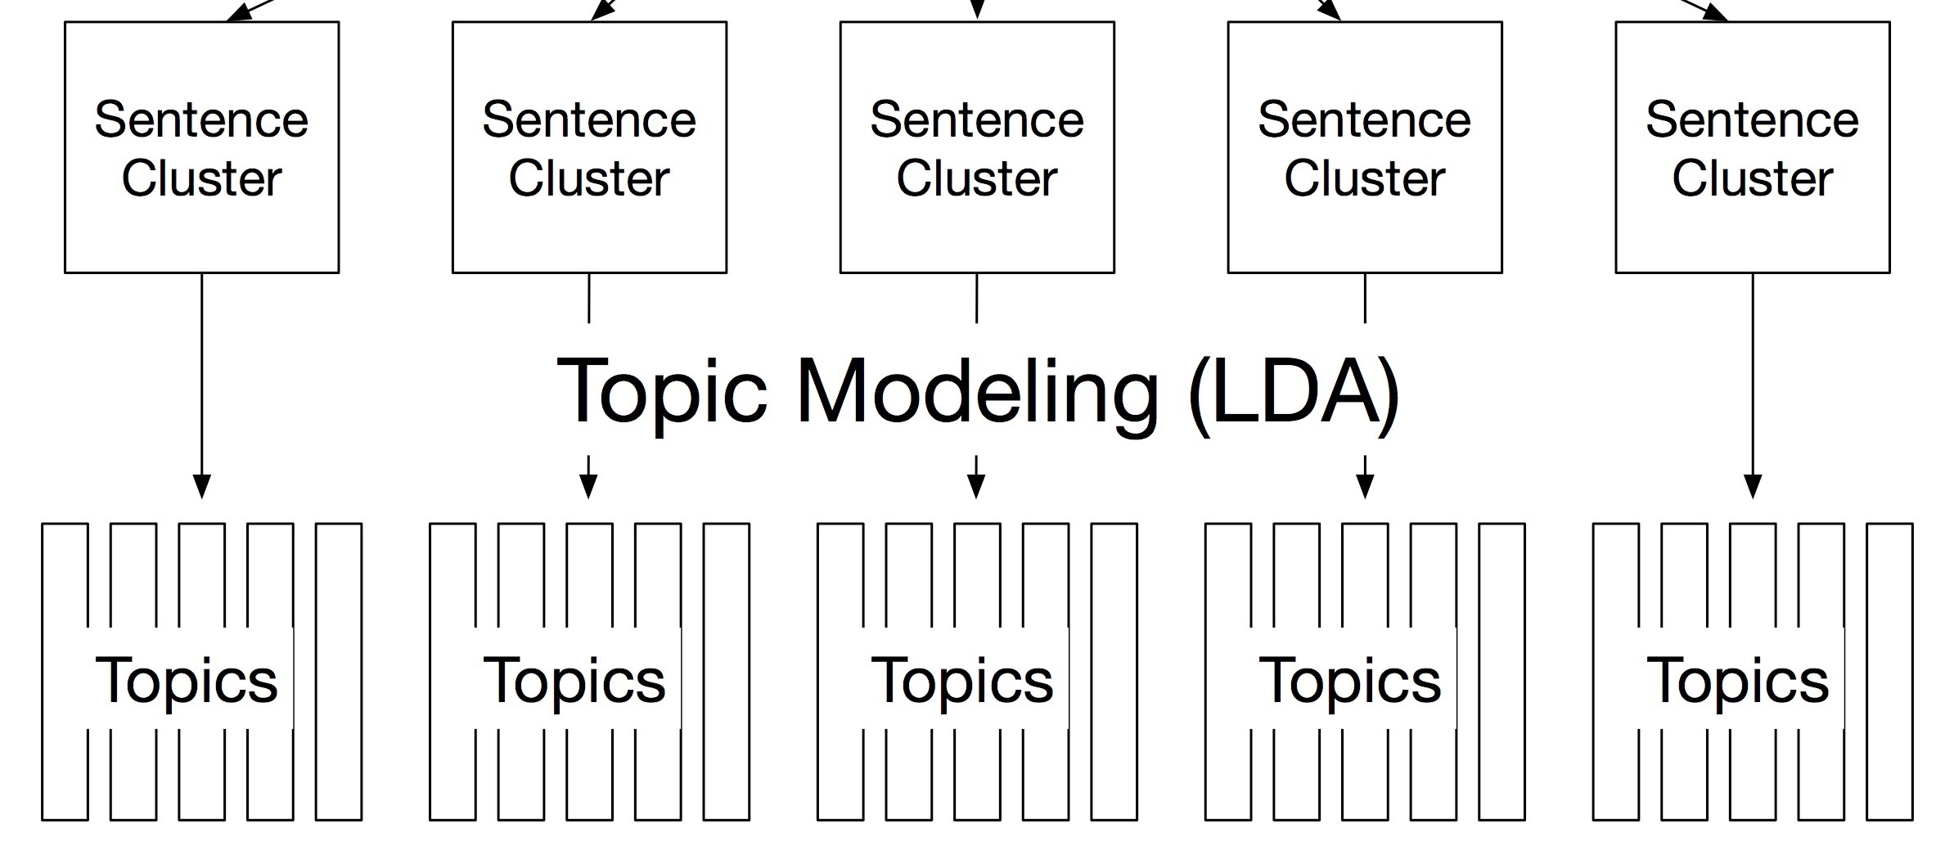
Potential Aspect Inference
collect sentences from the same review
Latent Dirichlet Allocation (LDA) within each sentence cluster
sentence level -> word level

Slide 14
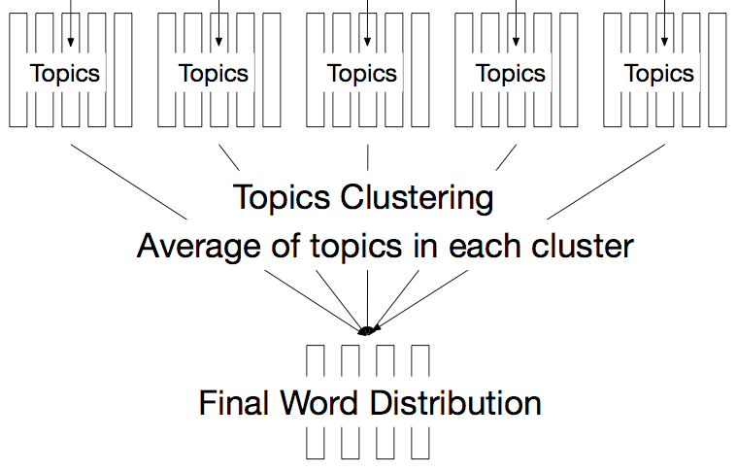
Overlap Resolution
Overlap between sentence clusters -> noises
K-Means on topic vectors

Slide 15
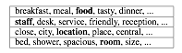
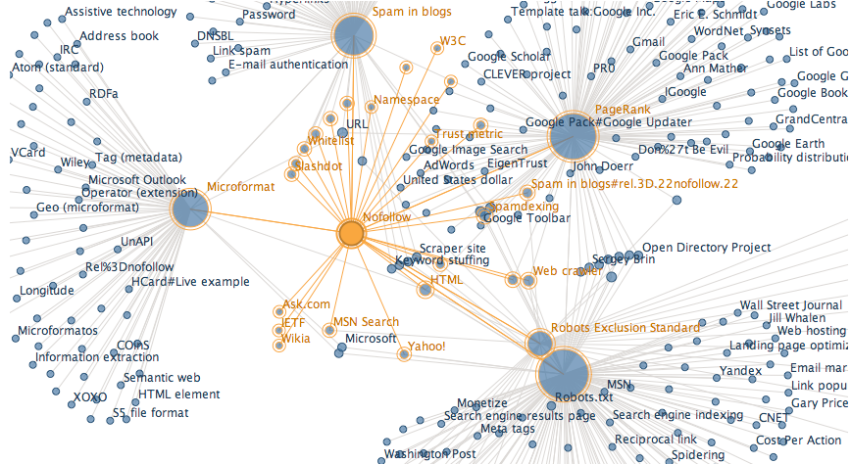
Ranking Phase
WordNet

Slide 16
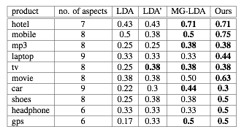
Hit-by-first

Slide 17
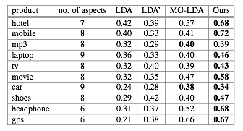
Smoothed Aspect Scores

Slide 18
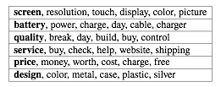

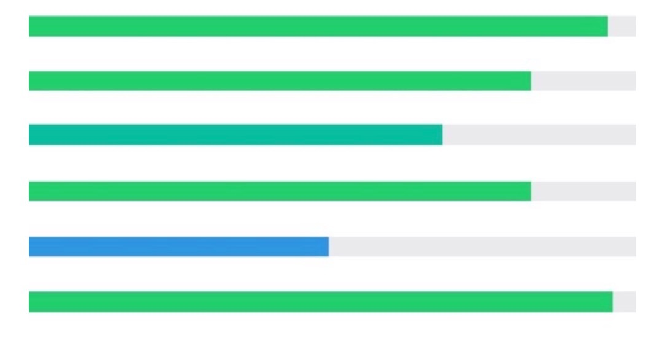
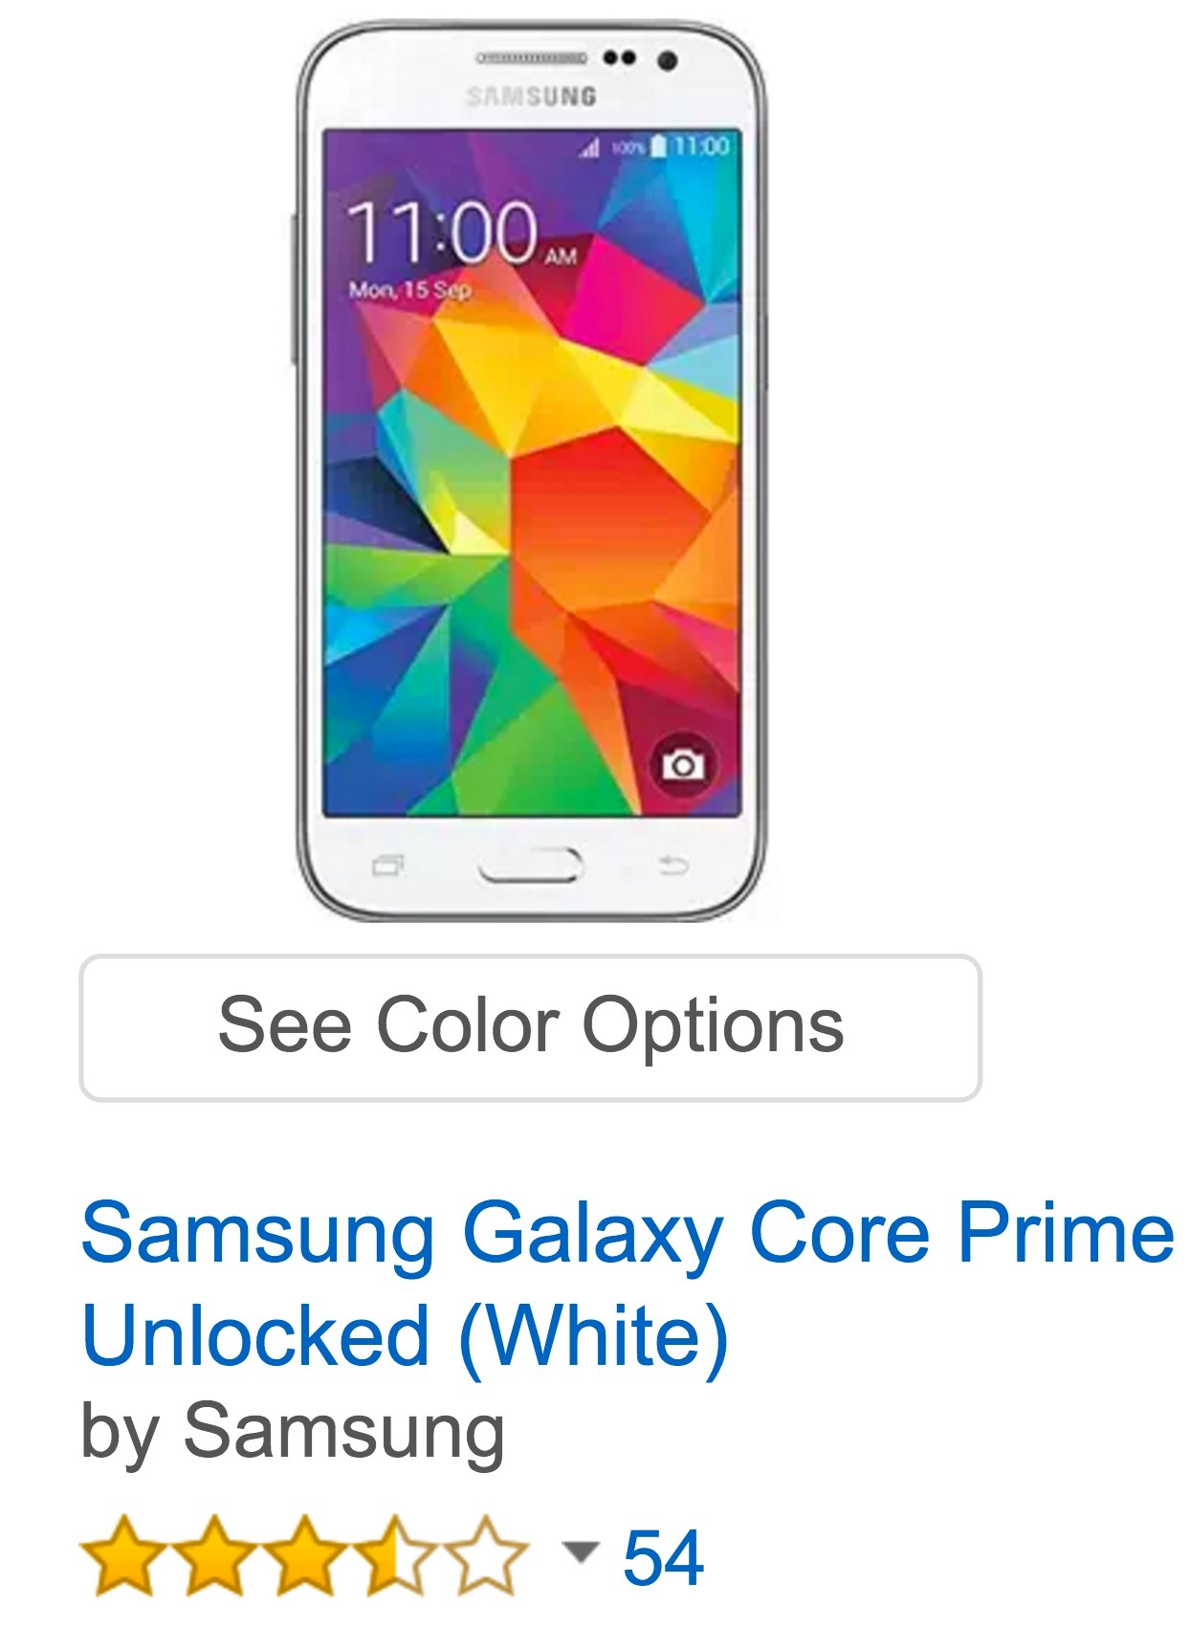
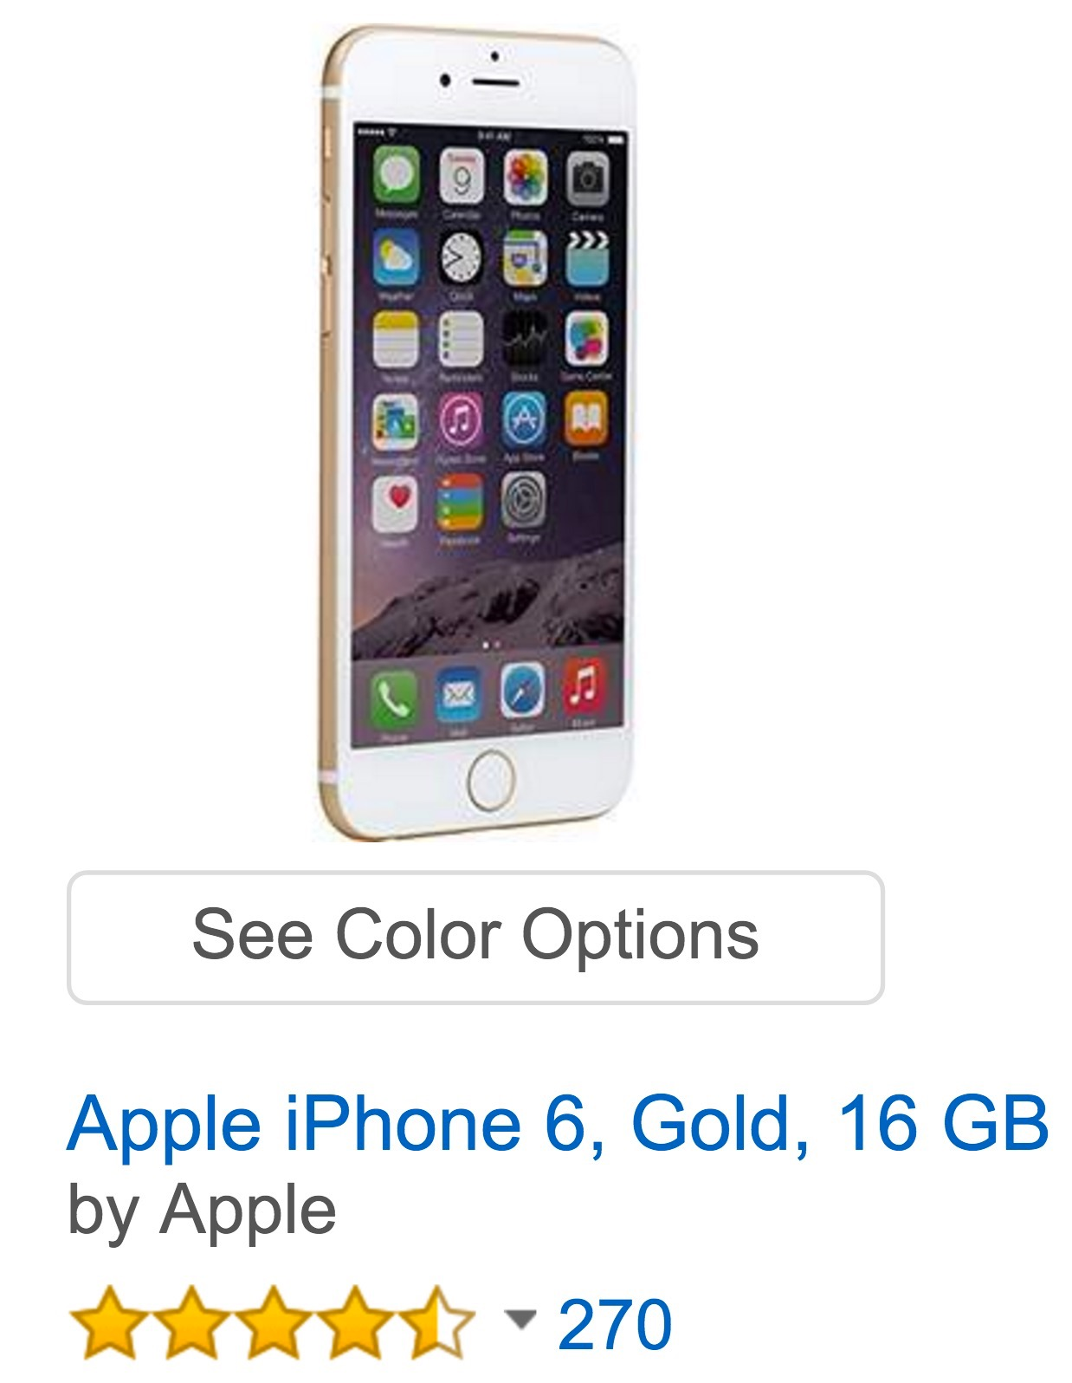
Case Study: Mobile Phone
Aspects
Screen
Battery
Quality
Service
Price
Design
Galaxy Core Prime
iPhone 6

Slide 19
Contributions
Survey on aspect-based opinion mining
New framework for aspect extraction that leverages the latest development in neural network for NLP
Better performance than the previous state-of-the-art
In preparation for ICDM 2016

Slide 20
Backup Slides

Slide 21
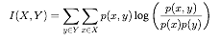
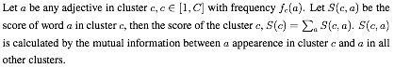
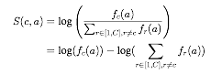
Ranking Clusters
Mutual Info:

Slide 22
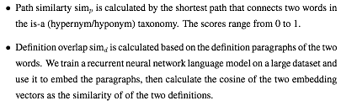
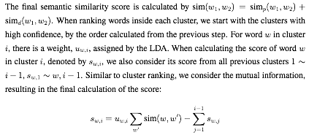
Ranking Words

